Slide 1
capstone project Secure Data Hiding in Images Using Steganography
Presented By: DHASWINI V
Student Name : DHASWINI V
College Name & Department :SRM Institute of Science and Technology & B.Tech computer science.

Slide 2
OUTLINE
Problem Statement
Technology used
Wow factor
End users
Result
Conclusion
Git-hub Link
Future scope

Slide 3
Problem Statement
Traditional cryptographic methods protect data but fail to conceal its existence, making it vulnerable to interception. Image steganography offers a solution by embedding secret data within images, but existing techniques face challenges such as detectability, vulnerability to compression, and limited payload capacity. There is a need for a more secure and robust steganographic method that ensures high imperceptibility while resisting steganalysis and attacks. This study aims to develop an improved approach for secure data hiding in images, enhancing both security and efficiency in digital communication.

Slide 4
Technology used
Several libraries are commonly used for implementing image steganography in Python:
OpenCV (cv2) – Used for image processing and manipulation.
Pillow (PIL) – Helps in handling image formats and pixel modifications.
NumPy (numpy) – Useful for numerical operations on image matrices.
Stegano – A dedicated Python library for LSB-based steganography.
PyCryptodome – Provides encryption features for added security.
Matplotlib (matplotlib.pyplot) – Used for visualizing images before and after steganography.
Several technologies are used for implementing secure data hiding in images using steganography, including:
Image Processing – Utilized for modifying and analyzing images (e.g., OpenCV, PIL).
Machine Learning & AI – Used for steganalysis (detecting hidden messages) and optimizing embedding techniques.
Cryptography – Enhances security by encrypting the hidden data before embedding (e.g., AES encryption using PyCryptodome).
Digital Signal Processing (DSP) – Used in transform-based methods like DCT and DWT for frequency-domain steganography.

Slide 5
Wow factors
Hybrid Steganography – Combines LSB with DCT/DWT for enhanced security and compression resistance.
Encryption Before Embedding – Uses AES/RSA encryption for double-layer protection.
AI-Based Adaptive Embedding – Machine learning selects optimal hiding spots to evade detection.
Steganalysis-Resistant Design – Randomized embedding to bypass modern detection tools.
Robust Against Compression & Noise – Ensures data remains intact after JPEG/PNG compression.
User-Friendly GUI – Real-time image quality analysis with PSNR/SSIM.
Blockchain for Verification – Secures hidden data using blockchain authentication.
Cloud & Cross-Platform Support – Web-based interface for secure data hiding anywhere.

Slide 6
End users
Cybersecurity Experts – Use steganography for secure data transmission and digital forensics.
Law Enforcement & Intelligence Agencies – Covert communication for surveillance and investigations.
Journalists & Whistleblowers – Securely share sensitive information without detection.
Military & Government Organizations – Protect classified communications from adversaries.
Data Privacy Enthusiasts – Individuals safeguarding personal or confidential data.
Healthcare & Medical Industry – Secure transmission of sensitive patient records via medical images.
Content Creators & Copyright Holders – Digital watermarking to prevent content piracy.
Corporate & Financial Sectors – Protect confidential business data from cyber threats.

Slide 7
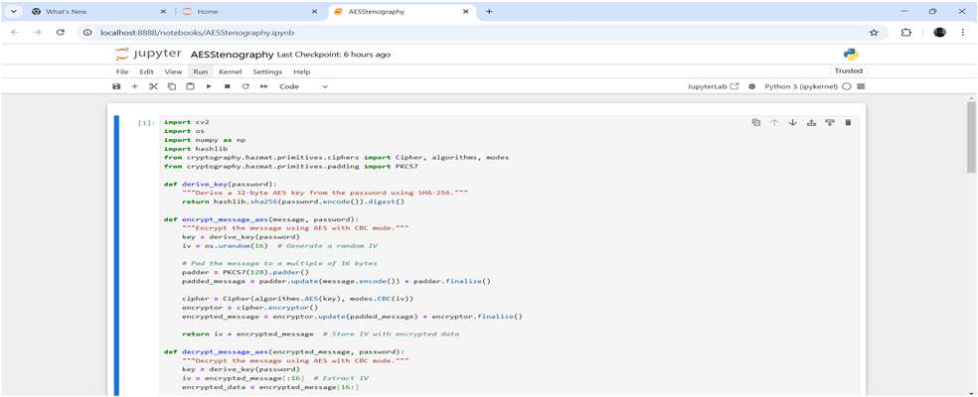
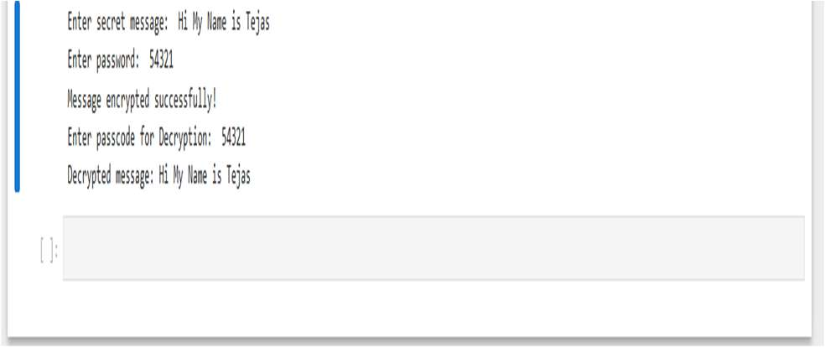
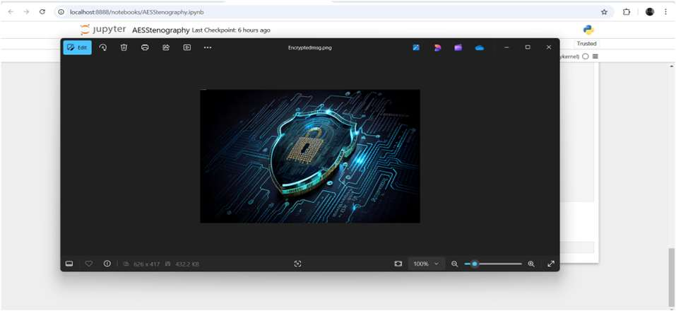

Results

Slide 8
Conclusion
This project addresses the limitations of traditional data security methods by implementing a secure, robust, and adaptive image steganography system. By integrating hybrid steganographic techniques (LSB, DCT, DWT), encryption (AES/RSA), and AI-based embedding, the proposed solution enhances imperceptibility, security, and resistance to steganalysis and compression. The system ensures secure data transmission for cybersecurity, intelligence, healthcare, and corporate applications. With its user-friendly interface, blockchain verification, and cross-platform support, this project stands out as a powerful tool for covert communication and digital privacy.

Slide 9
GitHub Link
https://github.com/dhaswini06/AICTE.git

Slide 10
Future scope(optional)
AI-Powered Steganography – Implement deep learning models to optimize data hiding and enhance steganalysis resistance.
Quantum-Secure Steganography – Explore quantum cryptography techniques to future-proof data security.
Real-Time Steganography – Develop live video and streaming-based steganographic techniques for secure communication.
Cloud & IoT Integration – Enable secure data hiding and retrieval in cloud storage and IoT devices.
Blockchain for Enhanced Security – Utilize decentralized blockchain networks for secure tracking and authentication of hidden data.
Multi-Media Steganography – Expand to audio, video, and 3D image steganography for broader applications.
Mobile & Web Applications – Develop cross-platform apps for easy steganographic communication on mobile and web.
Advanced Anti-Steganalysis Mechanisms – Implement stronger resistance against AI-based detection tools.

Slide 11
THANK YOU

